Slide 1

DAYALEKTOR
Belchez, Maica L. Carpio, Aira Joyce A. Gardon, Jana Marie G. Haboc, Florence Gail G.

Slide 2
Overview
Lean Canvas
Business Startup Cost
Revenue Projection
Online Surveys

Slide 3
Lean Canvas

Slide 4


Problems

Slide 5
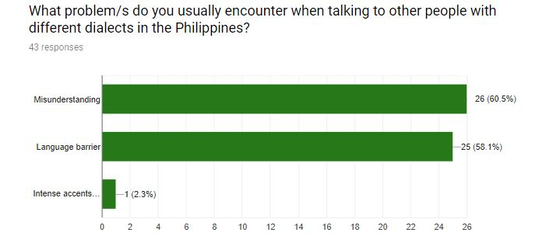

Slide 6
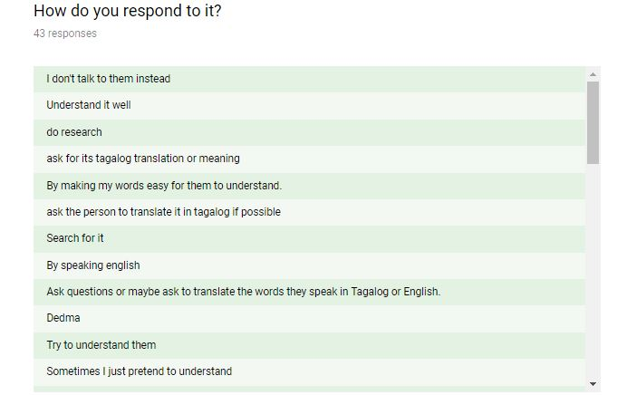
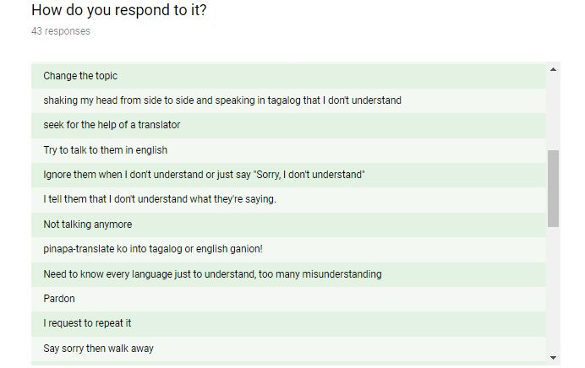
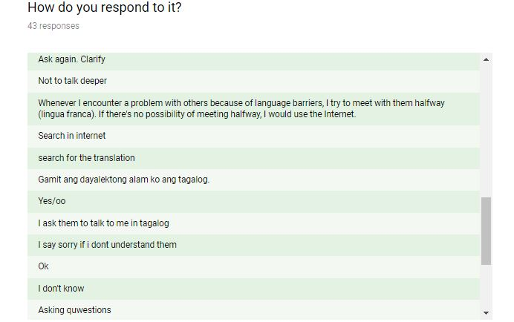
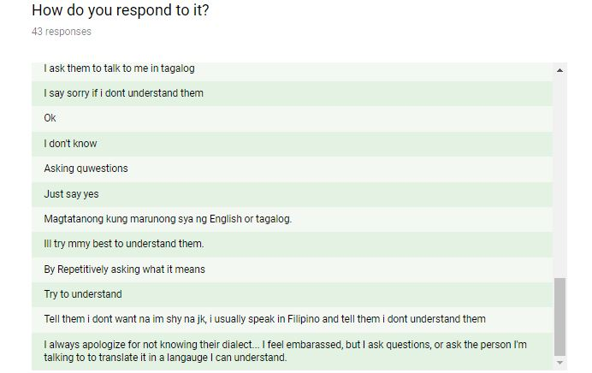

Slide 7



Solutions
Notes:
No more language barrier, Improve communication, lessen misunderstanding

Slide 8
Features
Philippine Dialects Translator
Offline Vocabulary Library
Word of the Day
Delegated Correction

Slide 9
Situational Benefits
Translate Philippine dialects into English or Filipino languages and vice versa
Improve vocabulary
Auto-respond to any set of phrases
Ask someone in the forum for correction
Notes:
Improve vocabulary, build self confidence in talking to other people using other dialect/languages – Benefits…
The rest capabilities

Slide 10
Marketing Message
“NEVER GET LOST IN TRANSLATION”

Slide 11
Channels
Social Networks
Blog
Advertisement
Email
Website

Slide 12
Customer Segments
Filipinos/Foreigners
Both female and male
18 and above
Tourists and Travelers

Slide 13
Travel Agency
Travel Company Website
D.O.T
Social Media Ads
Influencer’s Blog
Customer’s Feedback
Sales Funnel
Notes:
Explain how the influencer,
travel agency, company will benefit using the app. (Ano yung benefit na makukuha nila)
-Strategy natin paano mako-convince yung influencer na gamitin/advertise yung app natin.
> free trials
-Travel agency, specify yung percentage na makukuha nila.
>redirect to playstore
>I-include yung app sa package/promo

Slide 14
Cost Structure
Mobile Development
Marketing
Advertising
Salaries
Utilities

Slide 15
Revenue Streams
Stakeholders
Paid Customers
Development Fees

Slide 16
Business Startup Cost

Slide 17
Personnel | Salary (monthly) | Duration (month) | Total
Project Manager | ₱36,667 | 18 | ₱660,006
Business Analyst | ₱18,841 | 6 | ₱113,046
Mobile Applications Developer (Android) | ₱26,667 | 18 | ₱480,006
Database Developer | ₱15,501 | 9 | ₱139,509
Quality Assurance Analyst | ₱12,112 | 3 | ₱36,336
 |  |  | ₱1,428,903
Software | Price | Duration (month) | Total
Android Studio | Free | 18 | -
Firebase | Free | 18 | -
SQLite | Free | 18 | -
 |  |  | -
Facilities/Utilities/Equipment/Furniture | Price | Duration (month) | Total
Working Space | ₱9,000 | 18 | ₱162,000
Computers | ₱60,000 | 18 | ₱60,000
Laptops (for backup) | ₱30,000 | 18 | ₱30,000
Tables (4) | ₱2,185 | 18 | ₱8,740
Chairs (4) | ₱980 | 18 | ₱3,920
Aircon | ₱2,413 | 18 | ₱2,413
Internet Access | ₱1,797.05 | 18 | ₱32,346.90
Electricity, Water | ₱2,568.21 | 18 | ₱46,227.78
 |  |  | ₱345,647.68
Advertisement | Price | Duration (month) | Total
Advertising | ₱10,000 | 18 | ₱180,000
Marketing | ₱20,000 | 18 | ₱360,000
 |  |  | ₱540,000
Contingency Cost | ₱53,236.52
Overall Total | ₱2,367,787.20
Notes:
Hiwalay yung development phase.
Include yung capitalization
- pre op cost + 18 months
Revenue
- Net profit, pre op cost + 18 months and extend(3 years)
IMPORTANT
-wag tanggalin yung marketing and advertisement cost
>>>>>>>>>>>>>>>>>>>>>GOVERNMENT cost
-license fee…

Slide 18
Revenue Projection

Slide 19
GOAL
₱1,774,550.68 in sales within 548 days
That’s 33 downloads at ₱100 each
The conversion rate is 2.35%, there will be 1,378 users a day
Notes:
Based sa demographics(no. of users)
Demographics*price = Revenue cost

Slide 20
Online Surveys

Slide 21
Part 1 – Pain Points

Slide 22
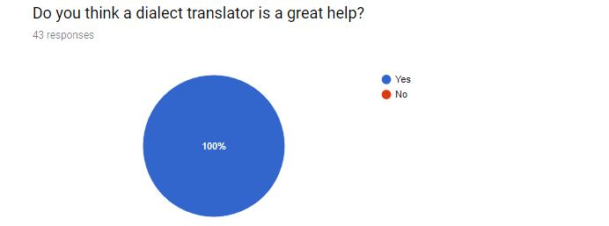
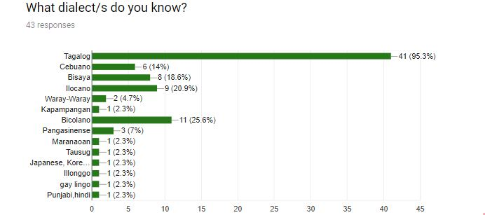

Slide 23
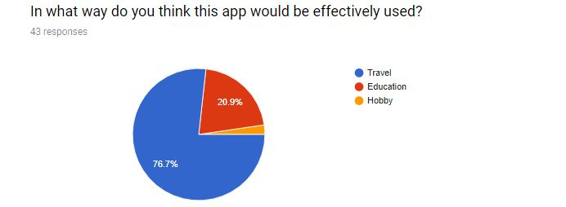
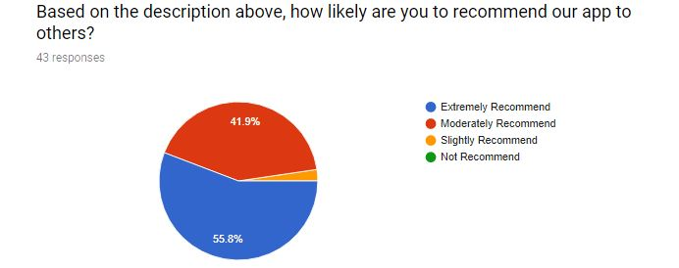

Slide 24
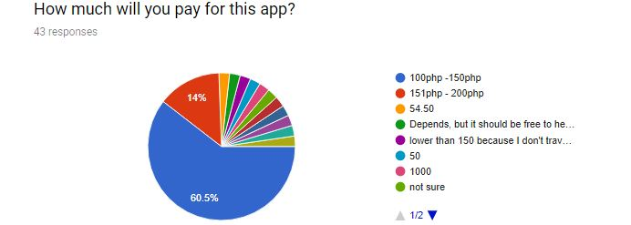
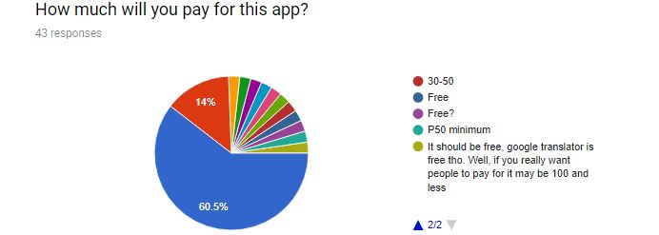

Slide 25
Part 2 – Features

Slide 26
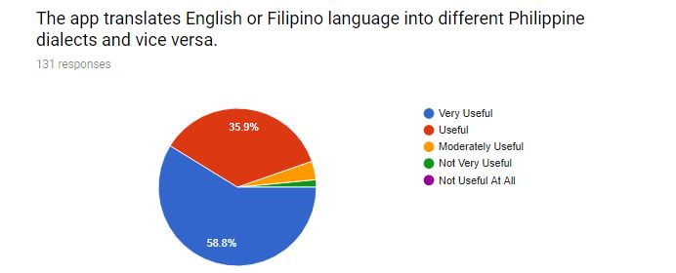
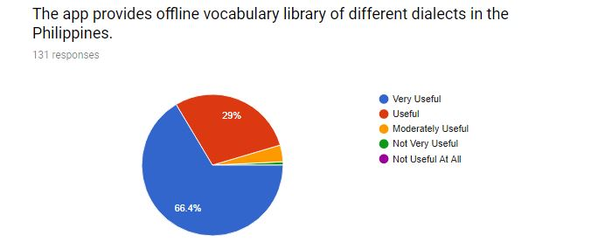

Slide 27
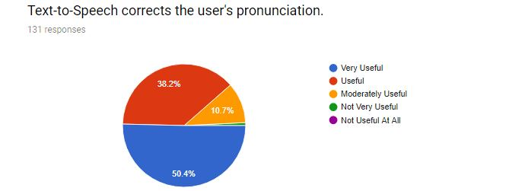
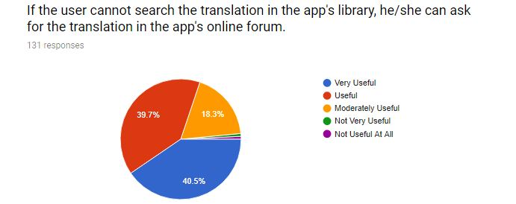

Slide 28
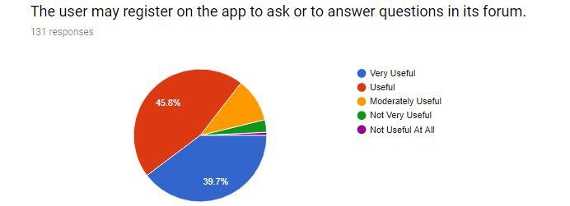
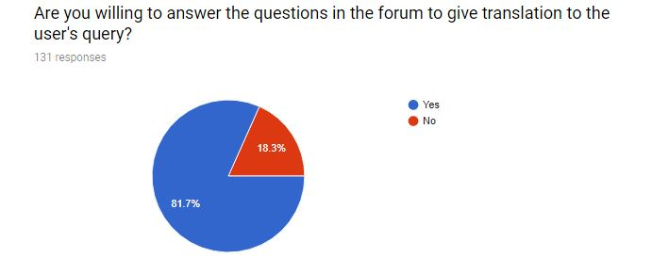

Slide 29
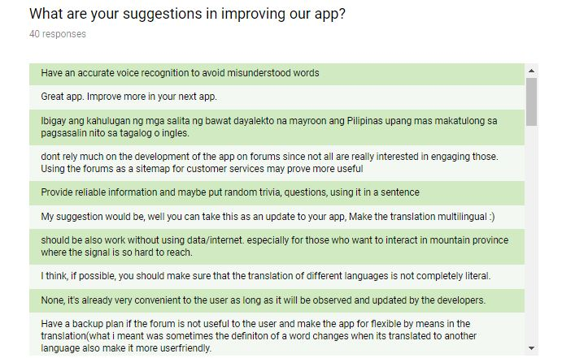
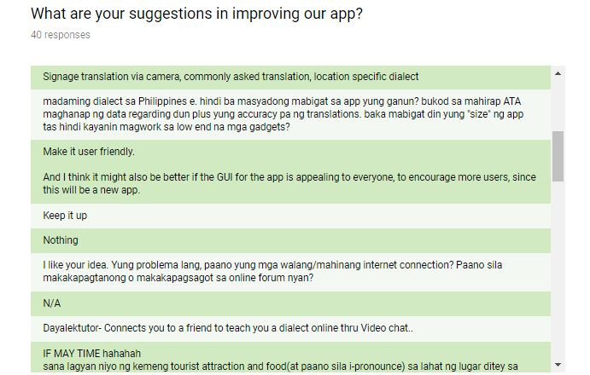
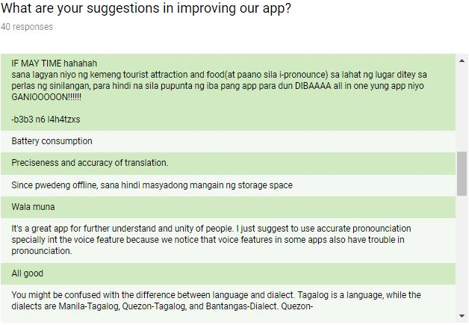

Slide 30
